Slide 1
Basic Details of the Team and Problem Statement
Ministry: Government of Jharkhand
PS Code: 1369
Problem Statement Title: Online integrated platform for projects taken up by the students of various universities/colleges
Team Name: Script Slingers
Team Leader Name: Pranav Kishor Patel
Institute Name: Vishwakarma Institute of Technology

Slide 2
Domain separation
Theme of website will be changed according to chosen domain giving user Tailored Experience.
Domain Specific Collaboration Tools.
Domain Specific mentor/students for project will be suggested.

Slide 3
Filters
Preferred domain of interest.
Based on Time Frame.
Paid or free projects.
Highly Rated projects, New Releases

Slide 4
AI Integration Script to Video
Video Summarization Of Projects
Effective Pitching Of Project Idea
Enhanced learning

Slide 5
Professor Profile
Maintaining Professor profiles to identify them as a mentor for project
Any new student can see the profile of the Professor of any other college and can approach the professor.

Slide 6
Student Profile
Every student profile will be maintained in our databases
Every student can see their past seen projects so that they can easily look back if they want.
Student can also save the project for future use.
Other student can also approach the talented student to work on a same project.

Slide 7
Recognition and Certificates/ Badges
Provide achievement to the contributors so that after every few contributions he/she will get a badge/verified certification that would boost the profile of a student.
Displaying the ordered list of students as well as mentors using this recognitions.

Slide 8
Project Matching and Suggestion
Help students find relevant projects and team members
Data Collection and Algorithm Development
Maintaining the Project data and User profile for recommendations.
Recommending projects based on past given ratings.

Slide 9
Language Support Tools
To reach the wider range of audience, we will integrate a language translate tool in our website.
Accessibility
Language Sensitivity

Slide 10
Data Privacy/ Robust Security System
Identify and Classify Data
Authentication and Authorization
Data Encryption
Privacy Policies and User Consent

Slide 11
Cost Analysis
Basic Website (data storage and functionality)
Database Size and Scalability
Functionality & Integration
Technology Stack
Hosting and Maintenance
Security and Compliance
Testing and Quality Assurance
Legal and Licensing
Support and Updates
$7000
$200
$10000
$10000
$500
$5000
$500
$1000
$5000
$39,200
According to the above cost analysis the decided cost per project download would be ₹150 and subscription cost per month will be ₹500

Slide 12
User Platform Navigation Tutorial
Provide the users with a video that would make the use of website effectively.
Improved Efficiency
Minimizing Support Requests
Reducing Frustration

Slide 13
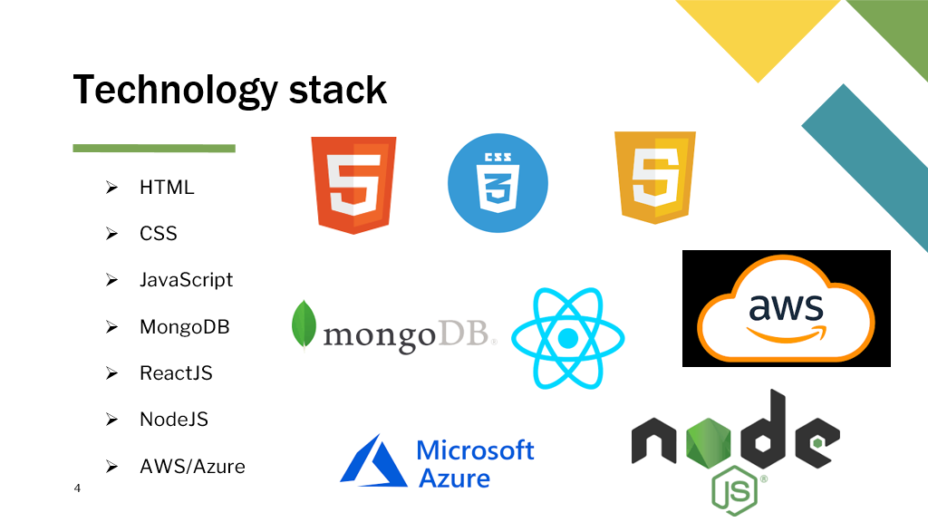
Other….
Funds raising for ongoing projects.
Inbuilt Plagiarism checker.
Discussion forums for collaboration.
Rating and feedback mechanism.
Provide demo templates to write research paper.
Filters
Chatbot Assistance

Slide 14
Thank You !!!..

